Slide 1
Design for manufacturing
Daniel Kritzinger
37427180@mynwu.ac.za

Slide 2
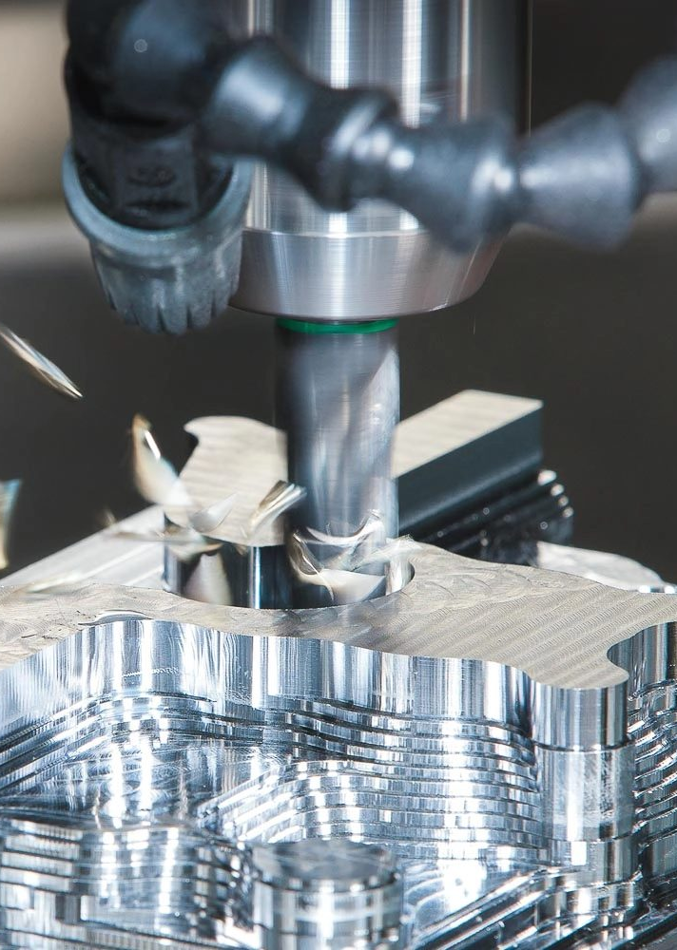

Thus far…
Requirements sorted
Functional flow agreed on
Physical architecture layout completed
Detail design finished
Components selected
DESIGN NOT COMPLETE UNTIL MANUFACTURABILITY HAS BEEN CONSIDERED.
Manufacturing constraints are design constraints.
For display purposes only
Notes:
At the end, you are actually going to have to build the thing you have designed. Make things easy for yourself by considering this aspect during the design process.
Waste of time to design something not manufacturable.

Slide 3
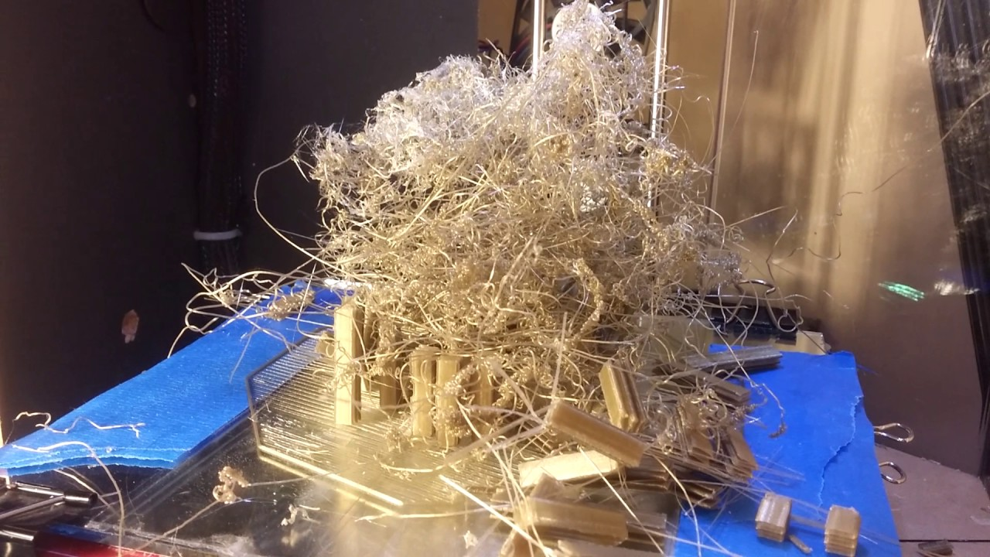
Manufacturing process selection Consider:
Geometry
Material
Function
Time/quantity
Cost
Notes:
Geometry: We do not 3D print a box. Flat parts are laser cut and assembled. For complex geometry, however, 3D printing comes in handy.
Material: Which material properties are needed? Water resistant? Structural integrity? Transparent?
Function: Structural or cosmetic?
Time: Manufacturing and post-processing time.
Cost: In real world, cost is obviously an important factor.

Slide 4
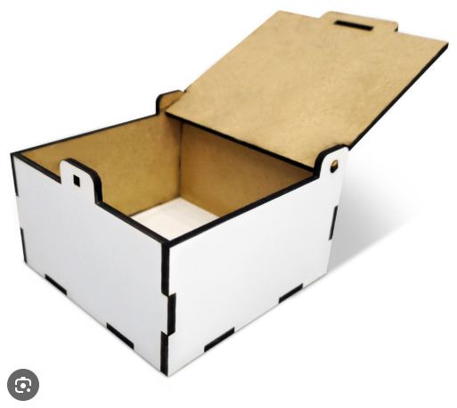
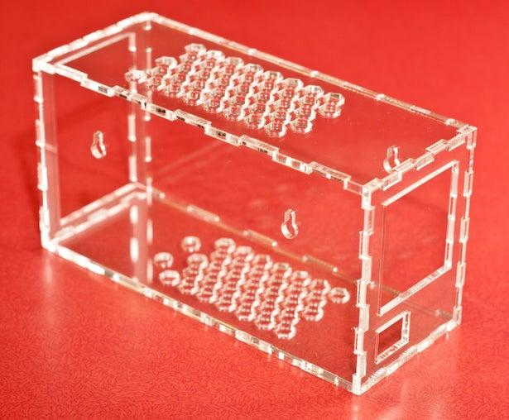

Laser cutting
Flat geometry
Good for enclosures and other structural elements.
Can be assembled if slightly more complex shapes or more thickness is desired.
Much faster and potentially cheaper than 3D printing for large parts.
Important considerations
DXF format
Consider machine limits regarding cutting area and material thickness
Distinguish cutting vs engraving lines
Consider kerf
Have a look at the eFundi site for detailed requirements.
Notes:
Flat brackets, spacers,

Slide 5
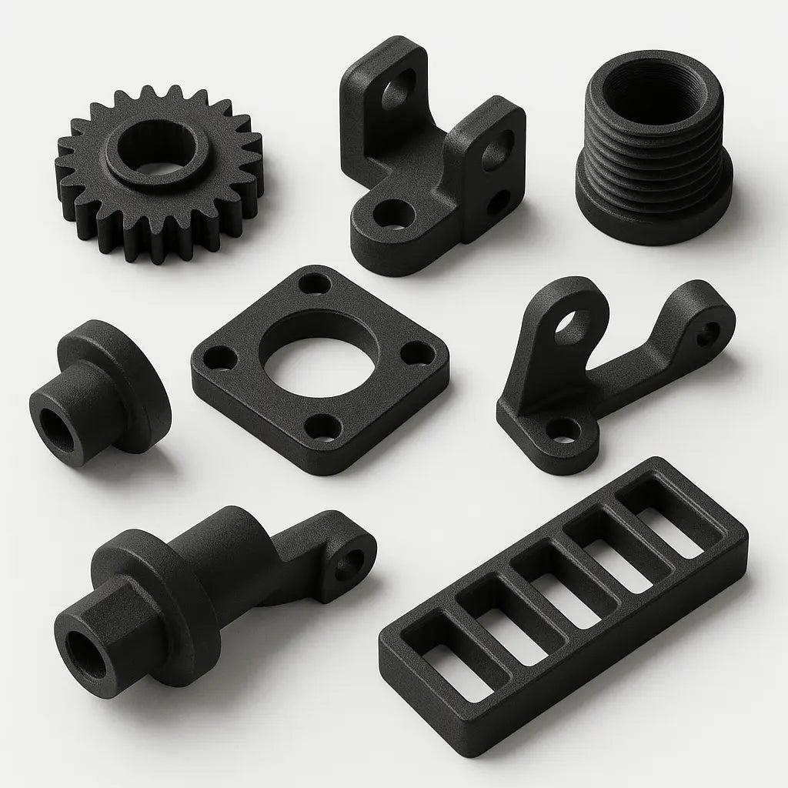
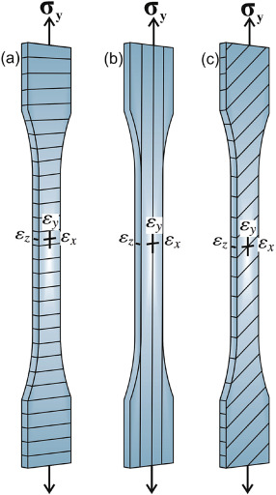
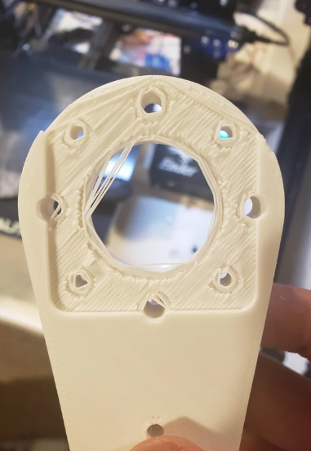
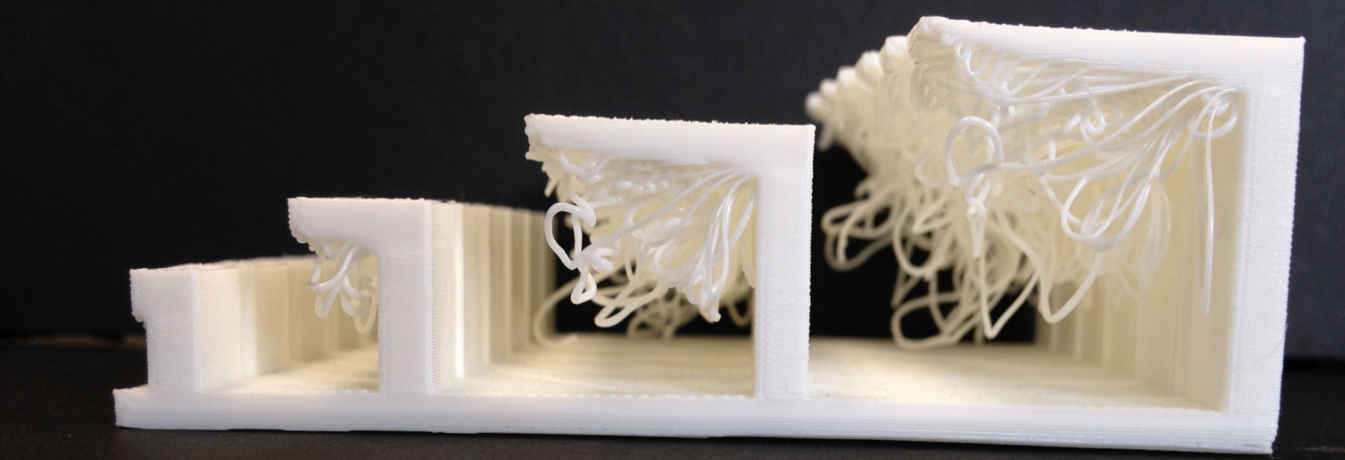
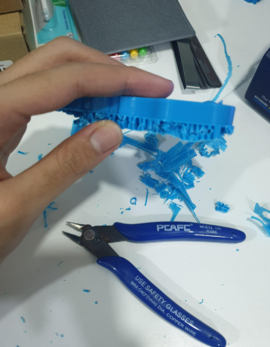
3D printing
Good for complex geometries like sensor mounts, knobs, gears and complex brackets.
Parts that can not be constructed from flat sheets
Large parts can be assembled from multiple prints if laser cut sheets and fasteners can not do the job.
Important considerations
Build volume and printing time
Minimise overhangs and supports and post processing
Mechanical strength – 3D prints are anisotropic.
Notes:
If large part – decide if it HAS to be one part, or if it could be assemble from smaller prints.
Hollow part example

Slide 6
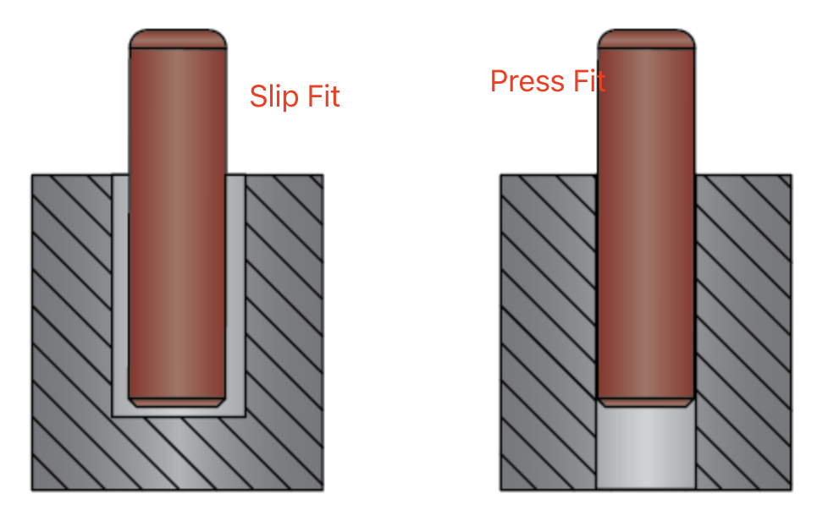
Tolerances and interfaces
Consider dimensional variation. A 5mm hole will likely measure closer to 4.7mm in the final print.
Include clearances where necessary, keeping the required fit type in mind.
“What happens if the manufactured part is 0.2mm larger than expected?”
Press fit vs Sliding fit
Notes:
Press fit – hole is slightly smaller than the shaft
Sliding fit – hole is larger than the shaft

Slide 7
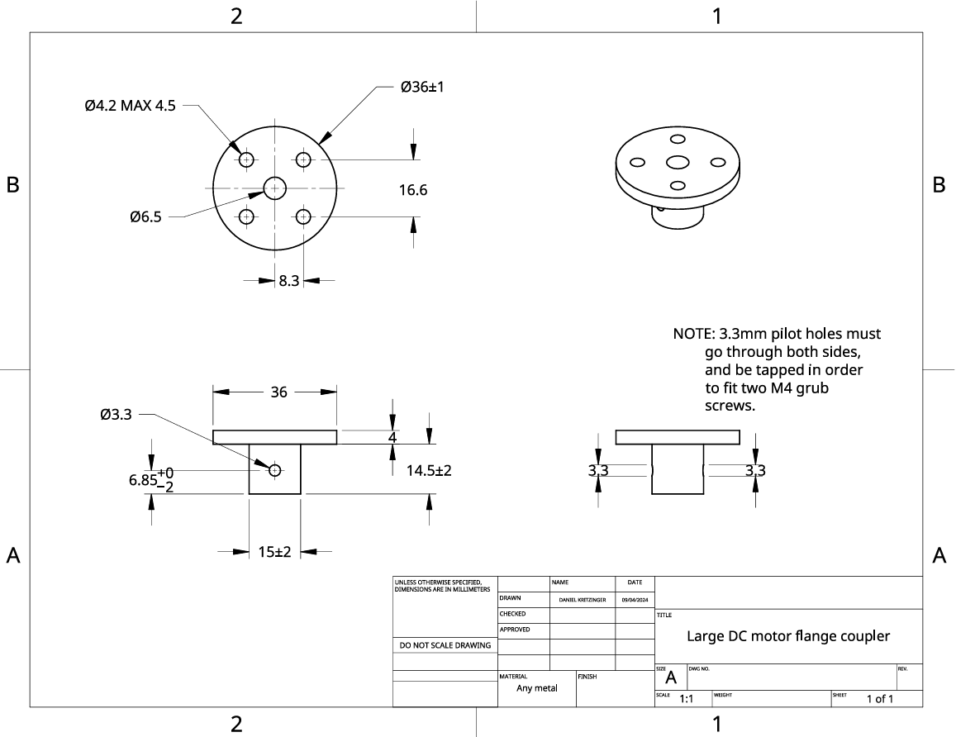
Fabrication lab
Lathe parts/welding
Steel/brass/aluminium
Remember HIRA

Slide 8
Design for assembly
DFM checklist
Does the part actually need to exist?
Can I buy it instead?
Most appropriate manufacturing process?
Which material?
Tolerances?
How long will it take to manufacture?
How will it be assembled?
Can it be easily repaired?
Are the limitations of the available machines considered?
A part can be manufacturable but still be horrible to assemble.
Can I reach that screw?
Can I insert that component once the whole system is assembled, and remove it again later?
Does assembly require three hands?
Are the wires accessible?
Can failed components be replaced? (from experience)
Design with manufacturability in mind.

Slide 9
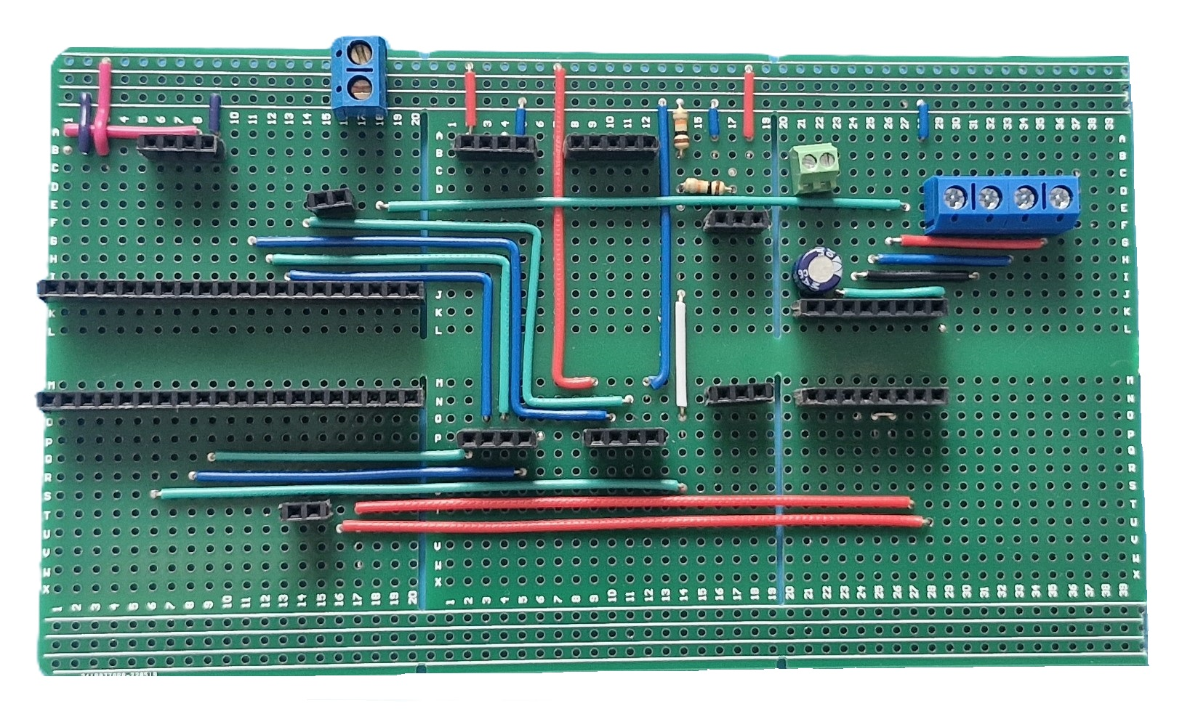
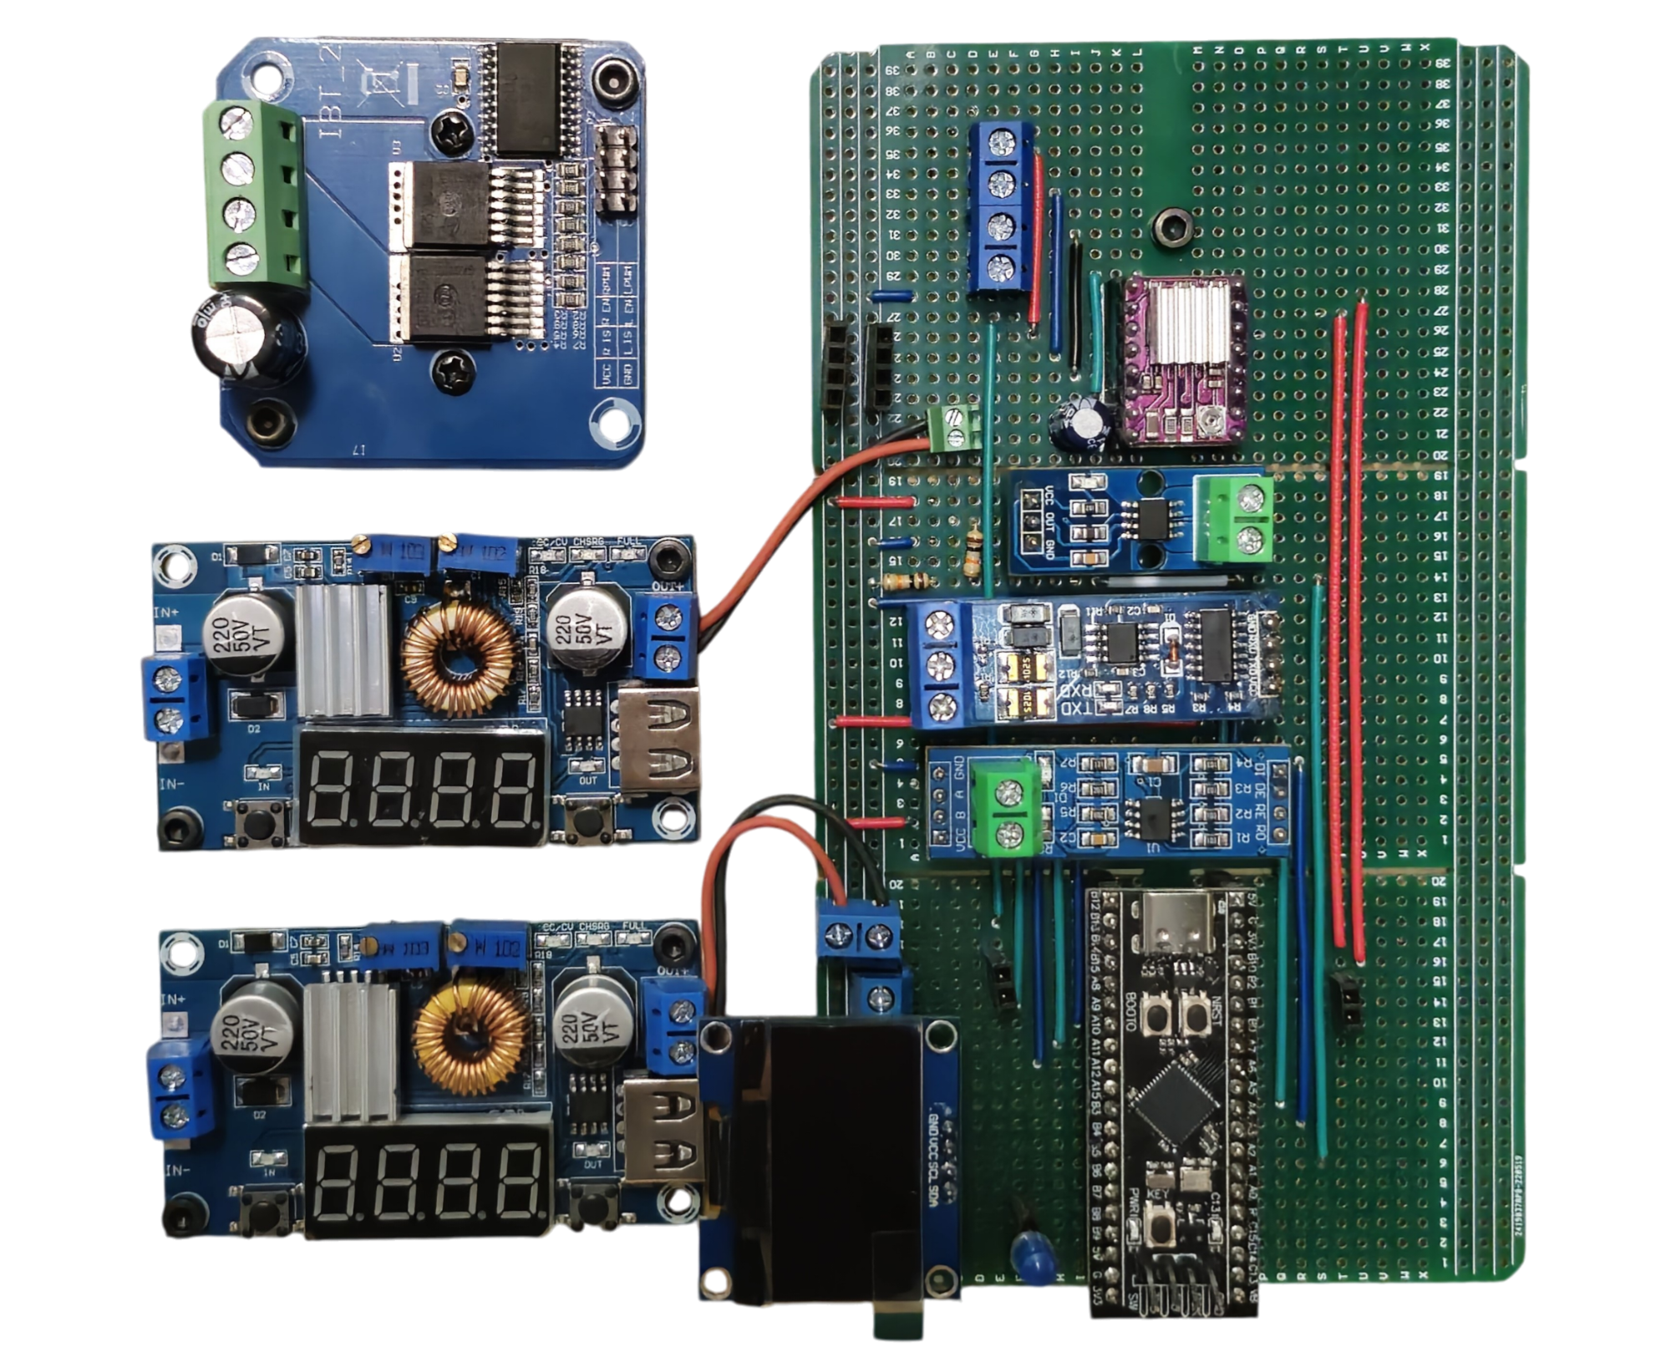
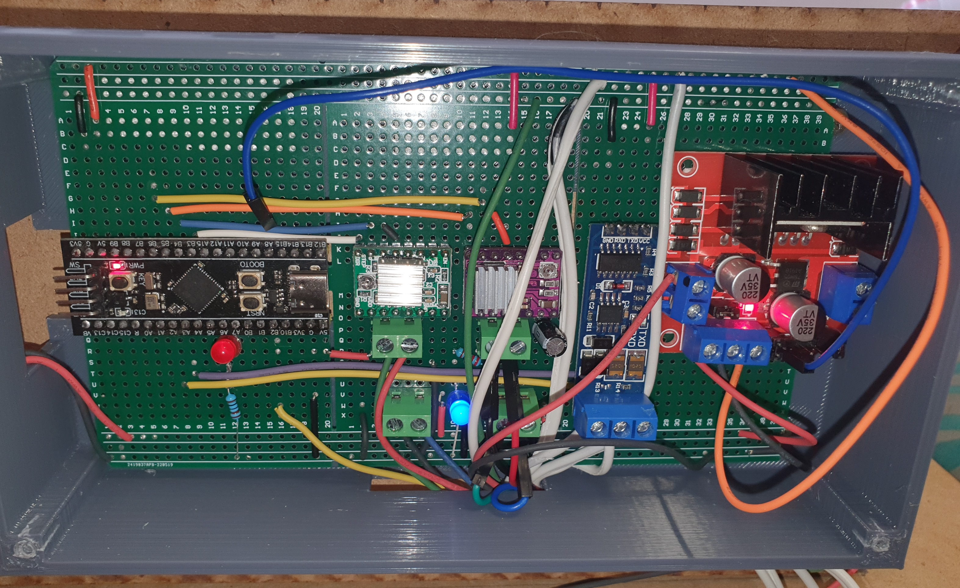
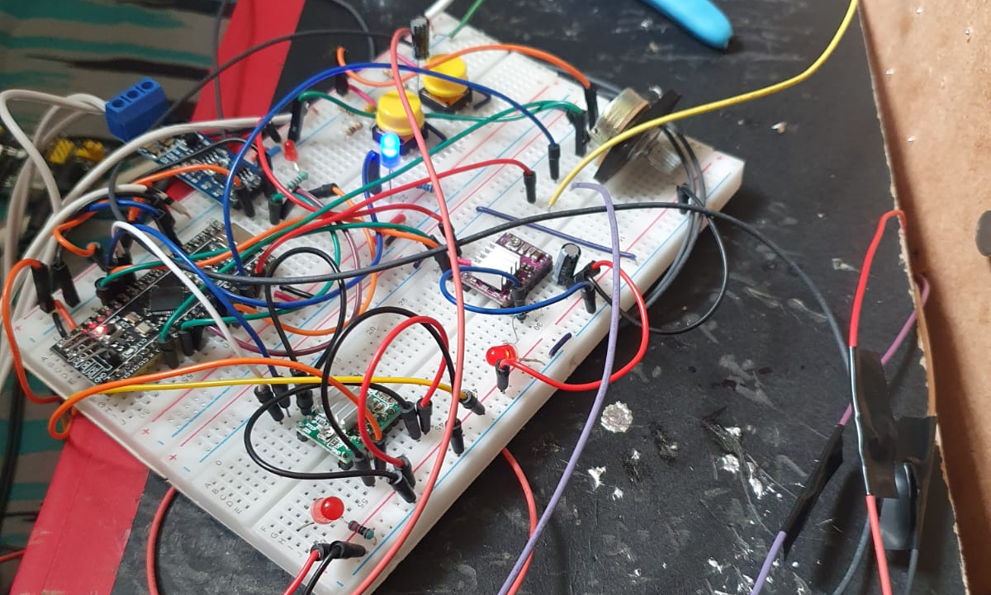
Some examples…

Slide 10
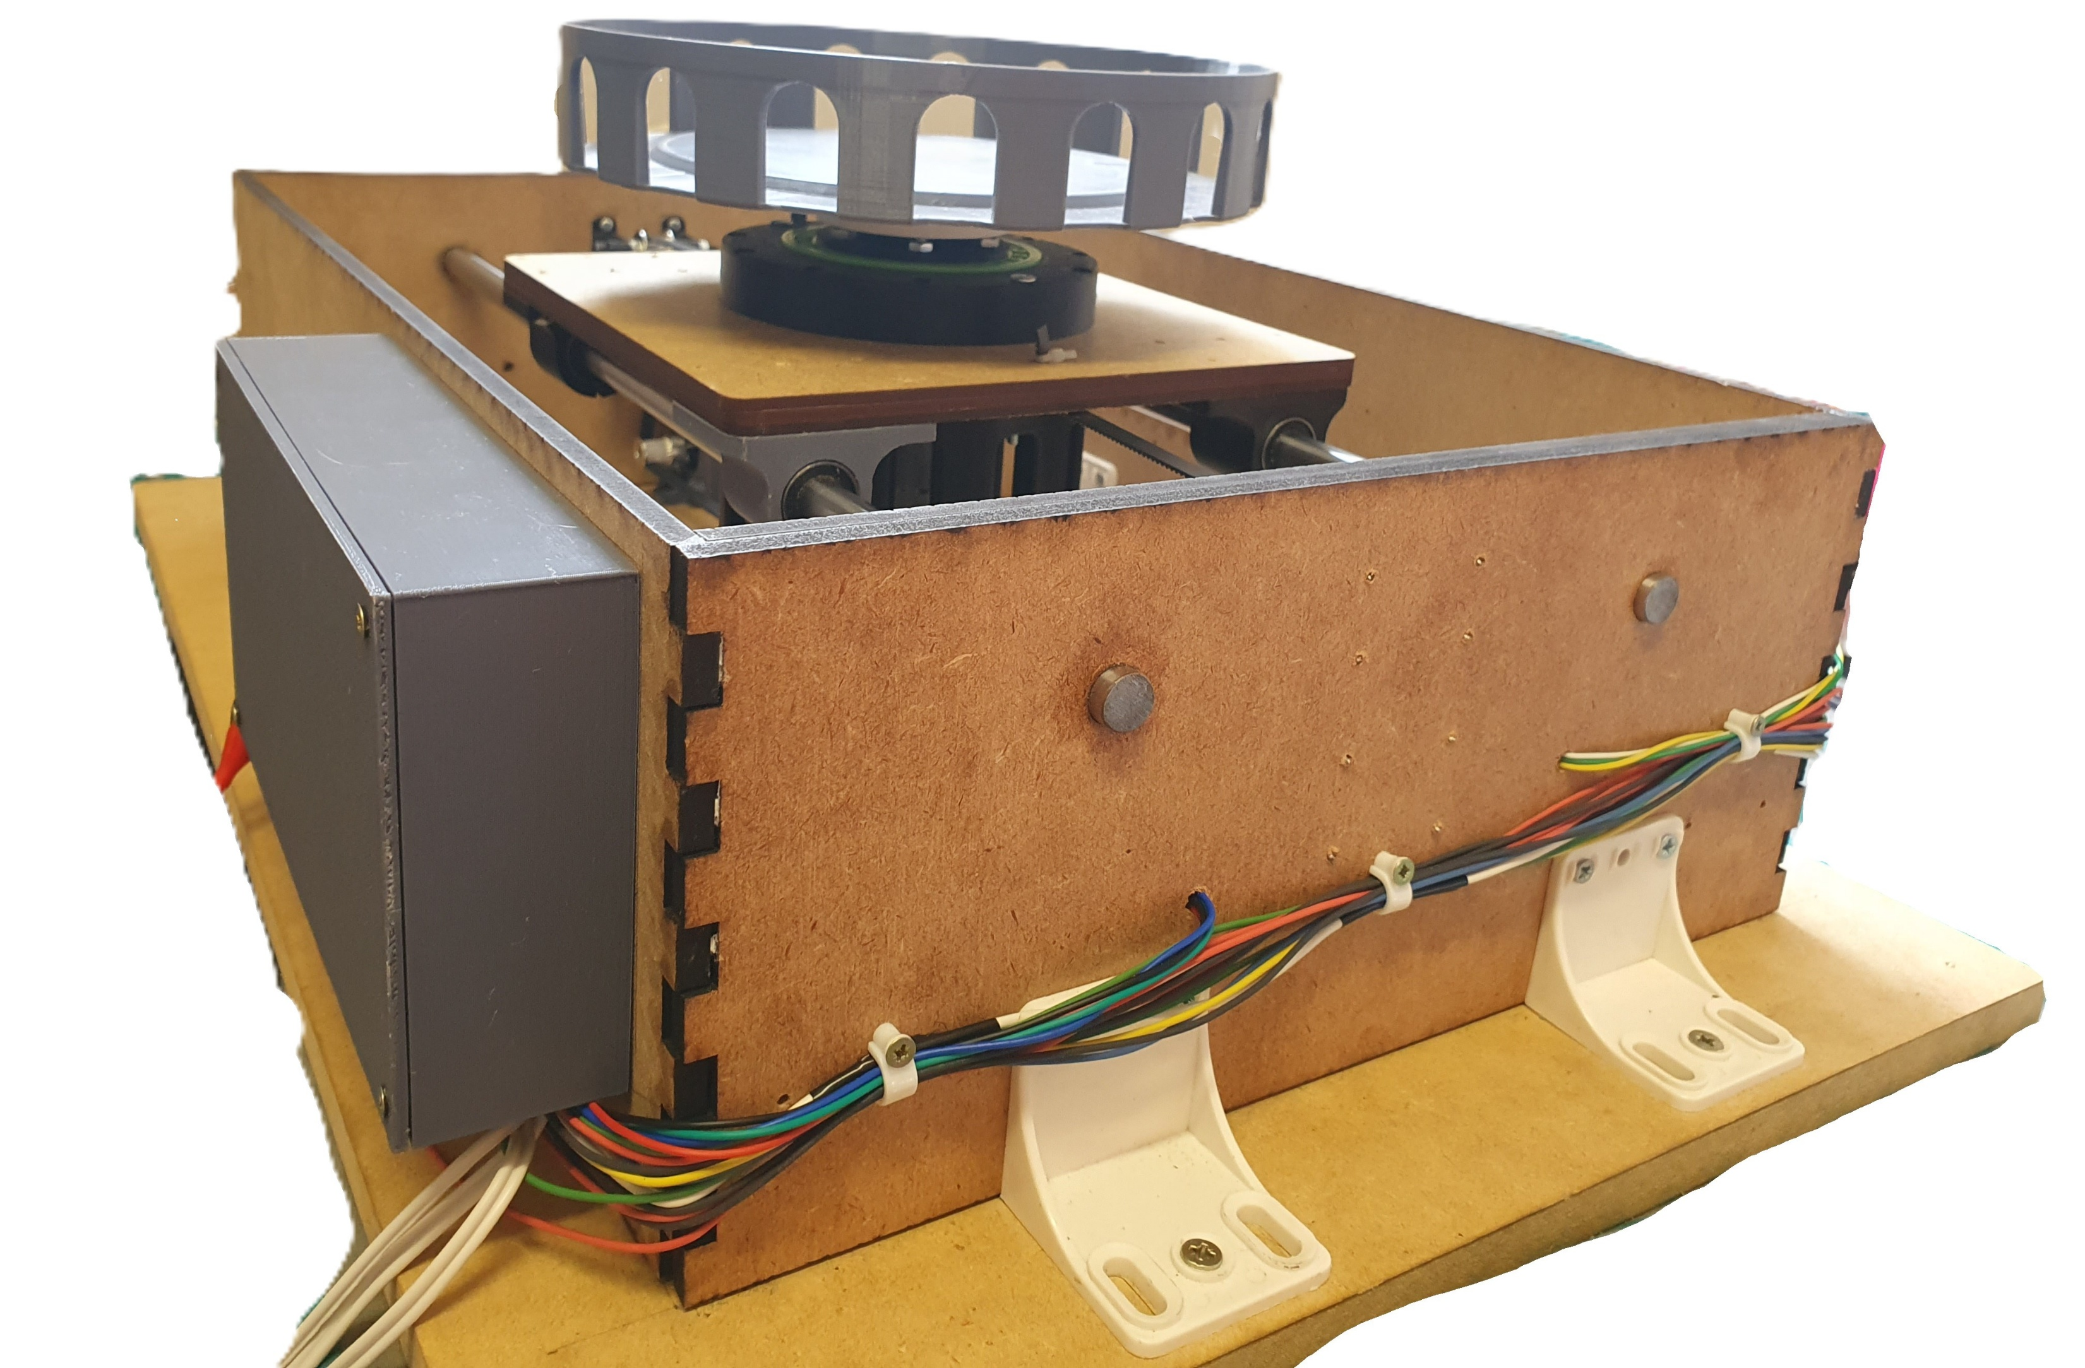
Some examples…

